Slide 1
Sine Rule Discovery

Slide 2
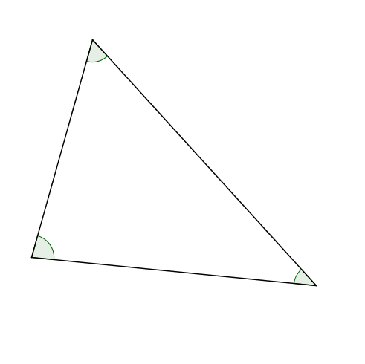
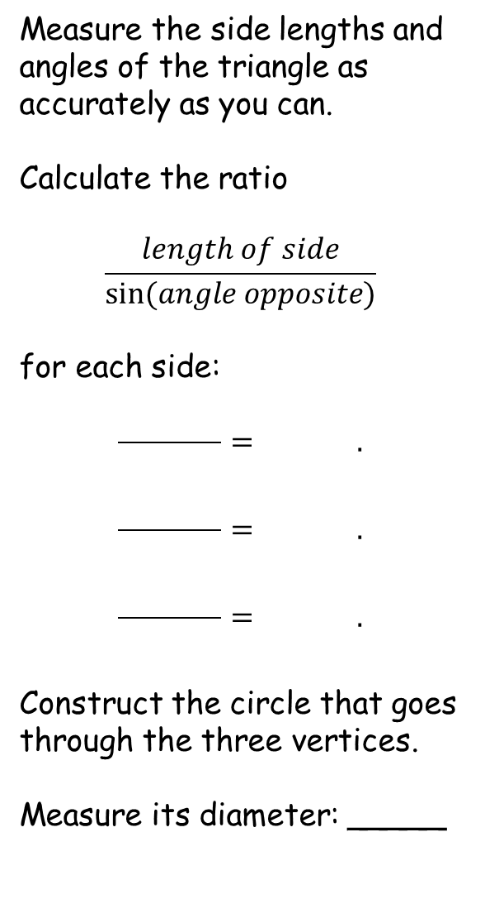
Measure the side lengths and angles of the triangle as accurately as you can.
Calculate the ratio
$$\frac{length of side}{sin⁡(angle opposite)}$$
for each side:
$$\frac{ }{ }= .$$
$$\frac{ }{ }= .$$
$$\frac{ }{ }= .$$
Construct the circle that goes through the three vertices.
Measure its diameter: _____
Sine Rule Discovery
Can you justify your findings?

Slide 3
Measure the side lengths and angles of the triangle as accurately as you can.
Calculate the ratio
$$\frac{length of side}{sin⁡(angle opposite)}$$
for each side:
$$\frac{ }{ }= .$$
$$\frac{ }{ }= .$$
$$\frac{ }{ }= .$$
Construct the circle that goes through the three vertices.
Measure its diameter: _____
Sine Rule Discovery
14.5cm
14.5cm
14.5cm
14.5cm
Can you justify your findings?
Notes:
80

Slide 4
Sine Rule Discovery
Summarising:
Each ratio should be the same – within the limits of experimental error.
Compare your results with your neighbour
  you have different triangles, how can the ratios be the same?
What about the diameter of the circumscribed circle?
  Again, you should all find it is the same
Let’s look at how to prove our results.

Slide 5
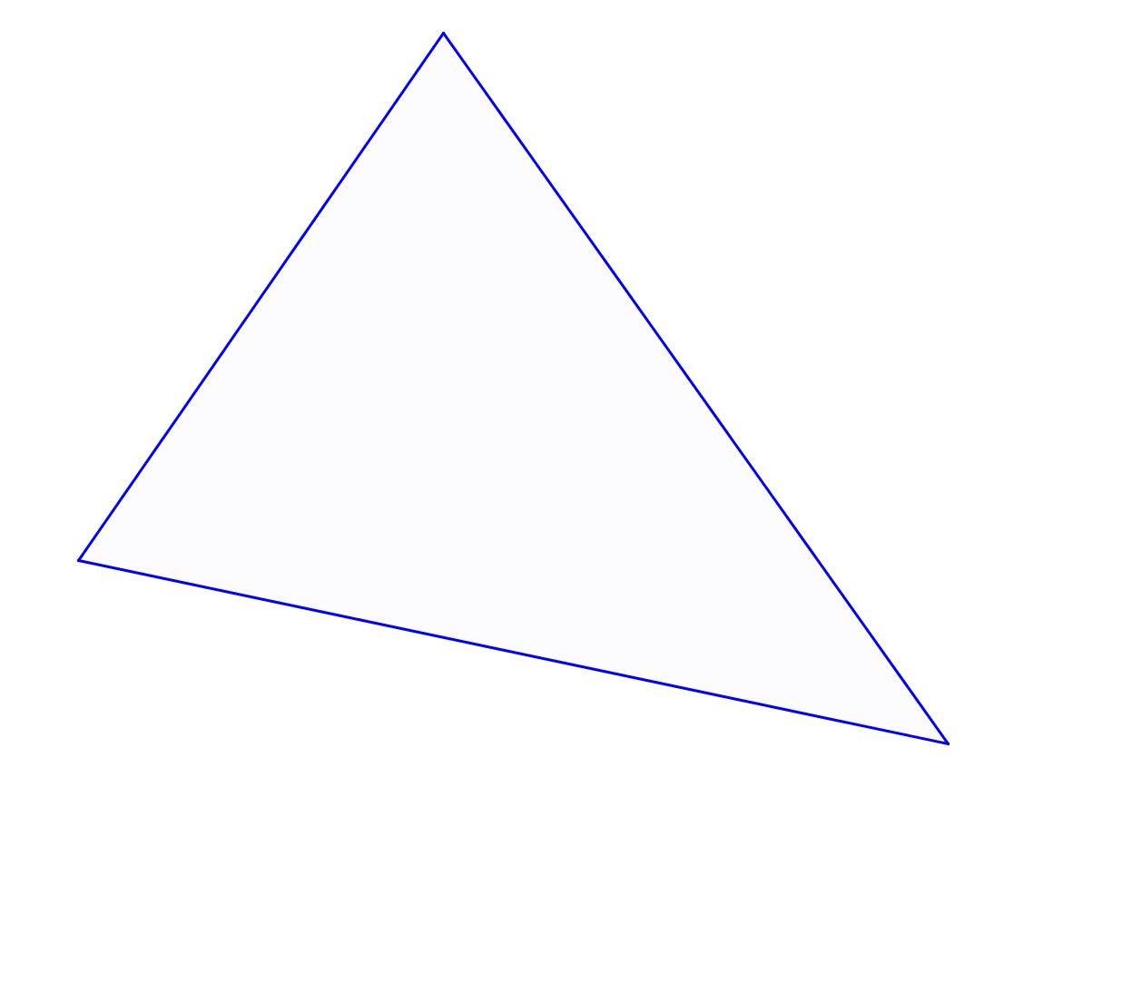





Proof of the Sine Rule
$$C$$
$$b$$
$$a$$
$$A$$
$$c$$
$$B$$

Slide 6
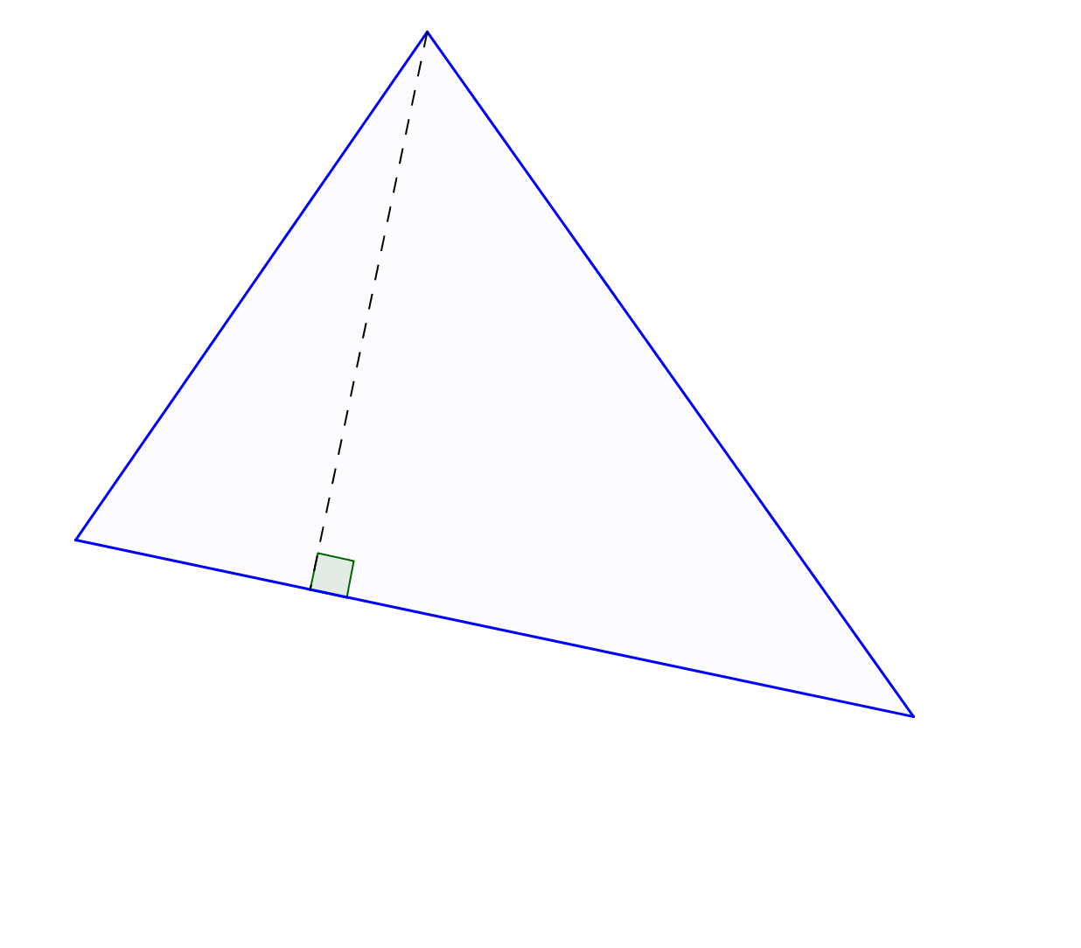
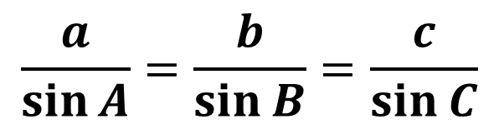




Proof of the Sine Rule
$$C$$
$$b$$
$$a$$
$$h$$
$$A$$
$$c$$
$$\sin{B}=\frac{h}{a}$$
$$h=a\sin{B}$$
$$\sin{A}=\frac{h}{b}$$
$$h=b\sin{A}$$
$$B$$
$$\frac{a}{\sin{A}}=\frac{b}{\sin{B}}=\frac{c}{\sin{C}}$$
$$a\sin{B}=b\sin{A}$$
(from symmetry)

Slide 7
Proof of the Sine Rule
$$C$$
$$b$$
$$a$$
$$h$$
$$A$$
$$c$$
$$\sin{B}=\frac{h}{a}$$
$$h=a\sin{B}$$
$$\sin{A}=\frac{h}{b}$$
$$h=b\sin{A}$$
$$B$$
$$\frac{a}{\sin{A}}=\frac{b}{\sin{B}}=\frac{c}{\sin{C}}$$
$$a\sin{B}=b\sin{A}$$
(from symmetry)

Slide 8
Proof of the Sine Rule
$$C$$
$$b$$
$$a$$
$$A$$
$$c$$
$$B$$

Slide 9
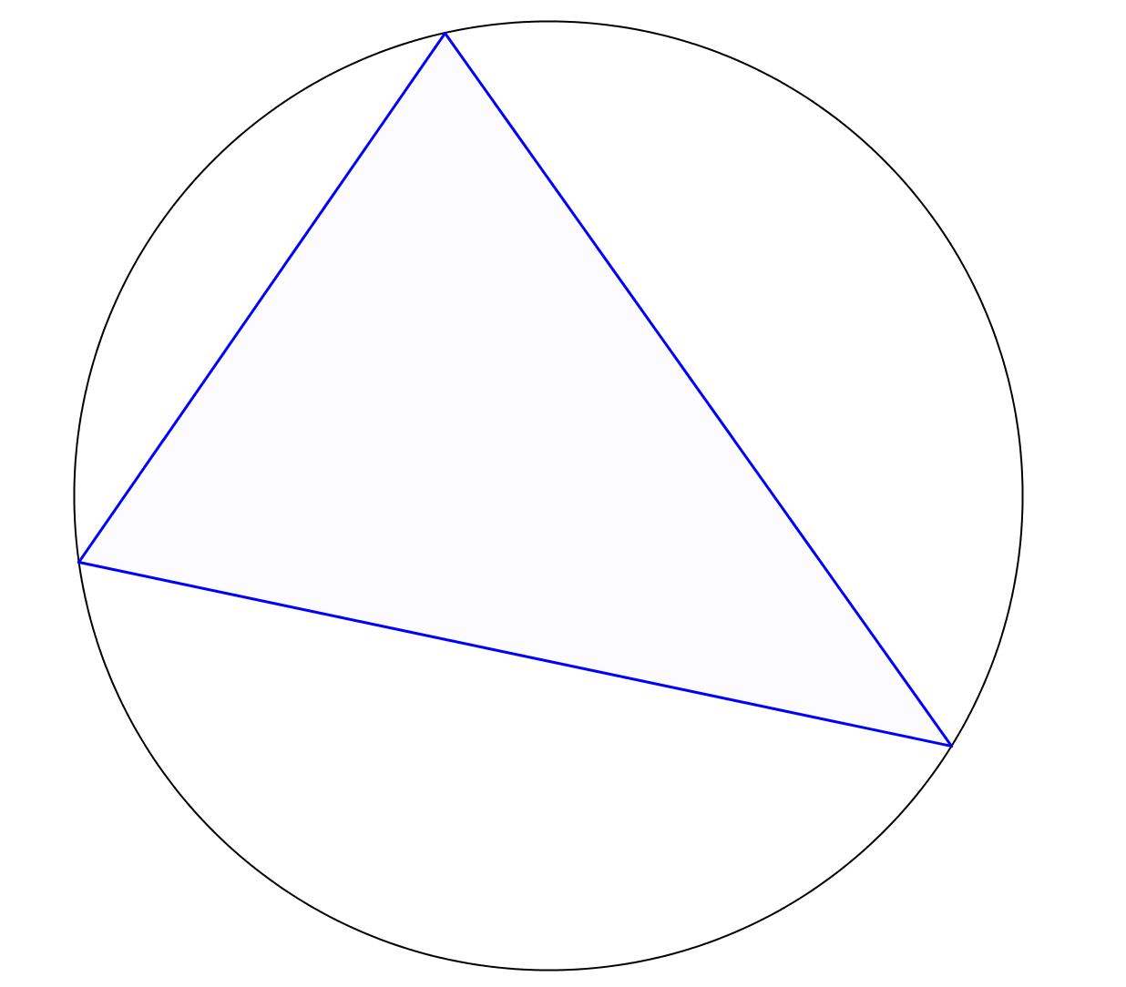
Proof of the Sine Rule
$$C$$
$$b$$
$$a$$
$$A$$
$$c$$
$$B$$

Slide 10
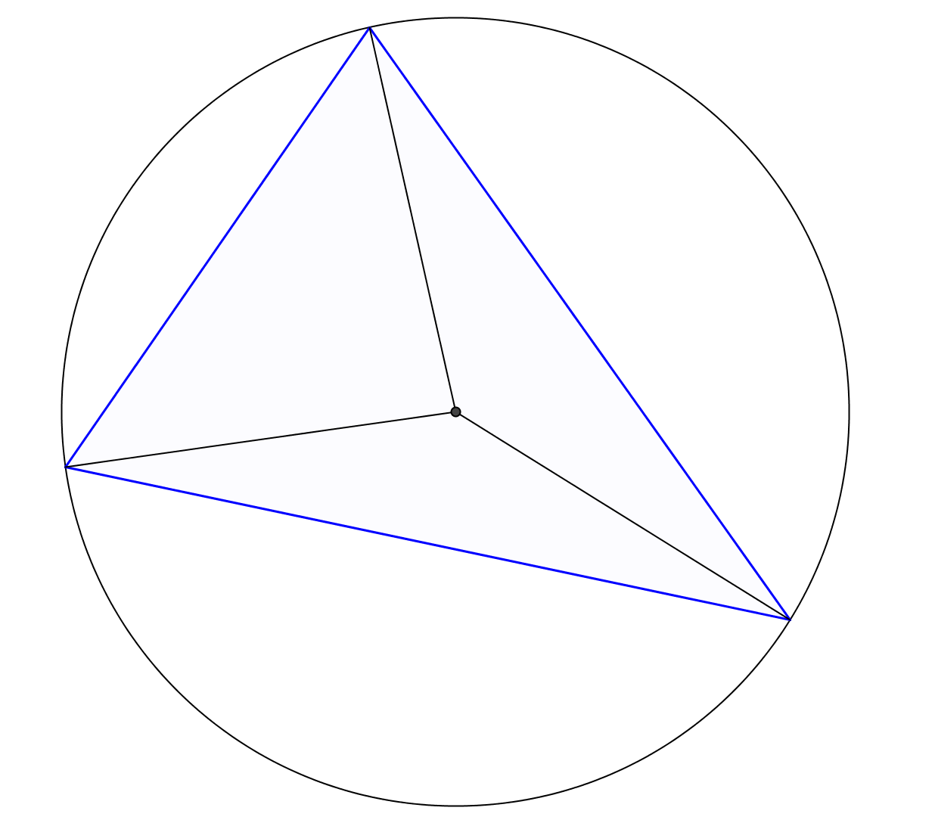



Proof of the Sine Rule
$$C$$
$$b$$
$$R$$
$$a$$
$$R$$
$$A$$
$$R$$
$$c$$
$$B$$

Slide 11
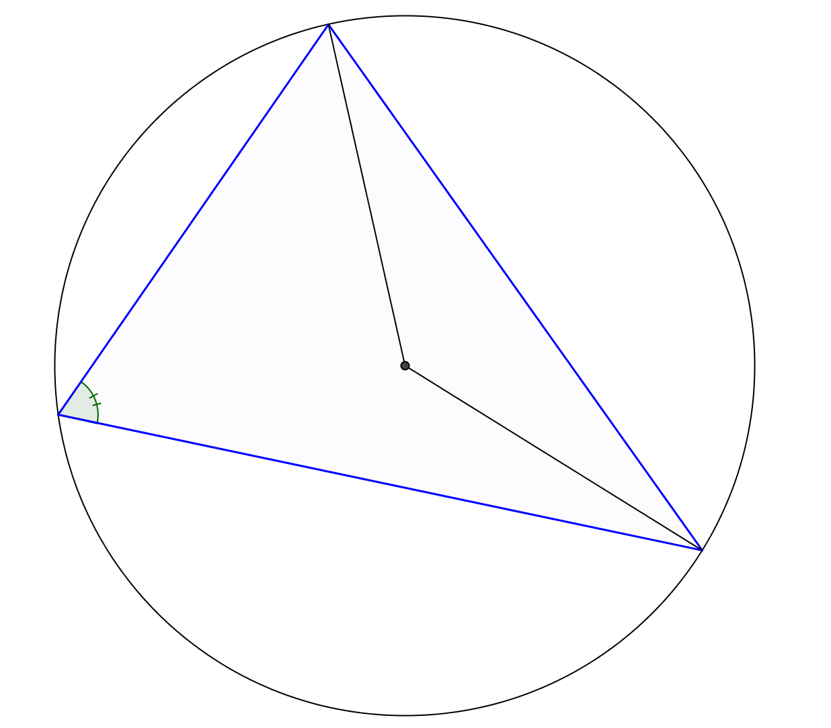
Proof of the Sine Rule
$$C$$
$$b$$
$$R$$
$$a$$
$$A$$
$$R$$
$$c$$
$$B$$

Slide 12
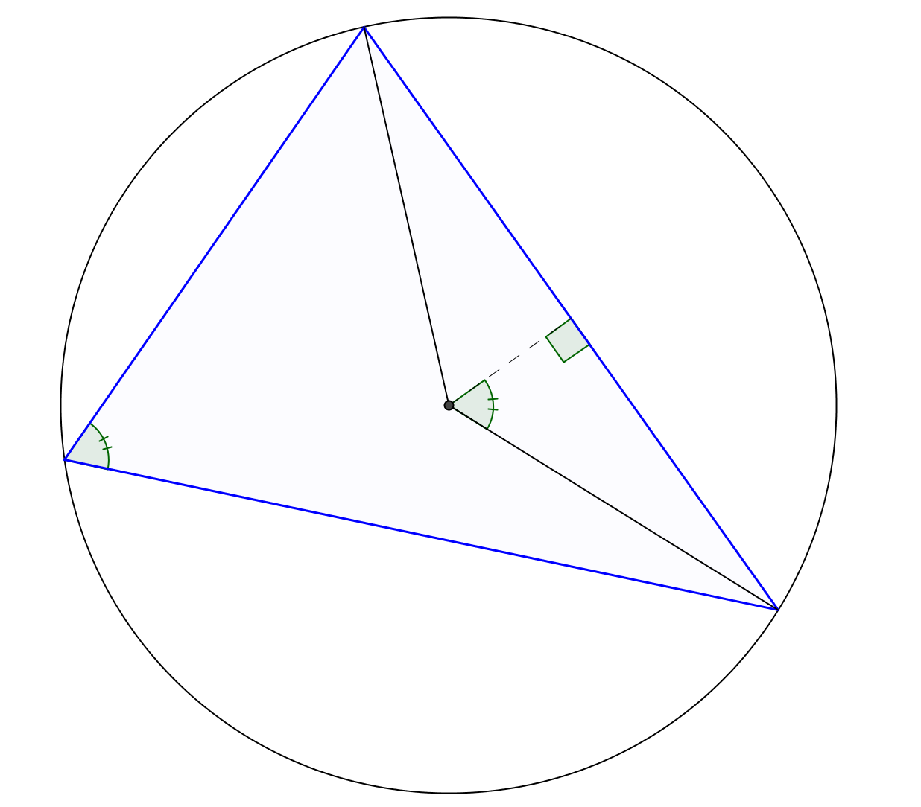
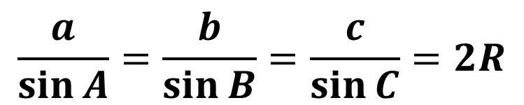


Proof of the Sine Rule
$$C$$
$$b$$
$$R$$
$$a$$
$$\frac{a}{2}$$
$$A$$
$$R$$
$$c$$
$$\sin{A}=\frac{\left(\frac{a}{2}\right)}{R}=\frac{a}{2R}$$
$$\frac{a}{\sin{A}}=2R$$
$$B$$
$$\frac{a}{\sin{A}}=\frac{b}{\sin{B}}=\frac{c}{\sin{C}}=2R$$

Slide 13
Proof of the Sine Rule
$$C$$
$$b$$
$$R$$
$$a$$
$$\frac{a}{2}$$
$$A$$
$$R$$
$$c$$
$$\sin{A}=\frac{\left(\frac{a}{2}\right)}{R}=\frac{a}{2R}$$
$$\frac{a}{\sin{A}}=2R$$
$$B$$
$$\frac{a}{\sin{A}}=\frac{b}{\sin{B}}=\frac{c}{\sin{C}}=2R$$

Slide 15
Note to Teacher
To start, it might be worth asking the pupils to draw their own triangle on the reverse of the worksheet and calculate the ratios.
Then they work on the given triangle.
This might make the impact of getting the same ratio for everyone a lot more forceful.

Slide 16
Resources

Slide 17
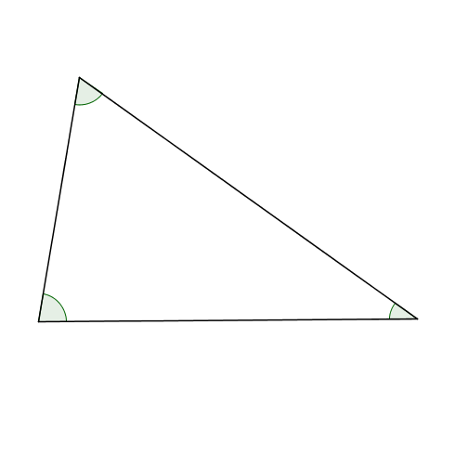
Measure the side lengths and angles of the triangle as accurately as you can.
Calculate the ratio
$$\frac{length of side}{sin⁡(angle opposite)}$$
for each side:
$$\frac{ }{ }= .$$
$$\frac{ }{ }= .$$
$$\frac{ }{ }= .$$
Construct the circle that goes through the three vertices.
Measure its diameter: _____
Sine Rule Discovery
Can you justify your findings?
SIC_2
Notes:
80

Slide 18
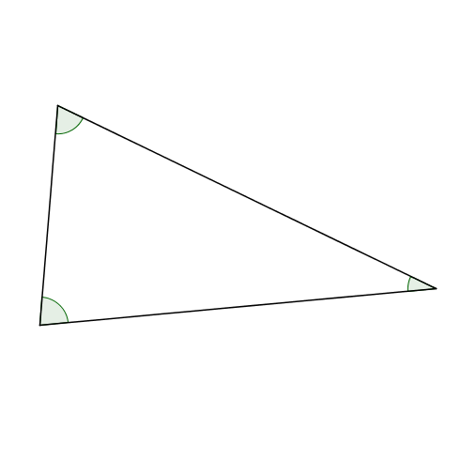
Measure the side lengths and angles of the triangle as accurately as you can.
Calculate the ratio
$$\frac{length of side}{sin⁡(angle opposite)}$$
for each side:
$$\frac{ }{ }= .$$
$$\frac{ }{ }= .$$
$$\frac{ }{ }= .$$
Construct the circle that goes through the three vertices.
Measure its diameter: _____
Sine Rule Discovery
Can you justify your findings?
SIC_2
Notes:
80

Slide 19
Measure the side lengths and angles of the triangle as accurately as you can.
Calculate the ratio
$$\frac{length of side}{sin⁡(angle opposite)}$$
for each side:
$$\frac{ }{ }= .$$
$$\frac{ }{ }= .$$
$$\frac{ }{ }= .$$
Construct the circle that goes through the three vertices.
Measure its diameter: _____
Sine Rule Discovery
Can you justify your findings?
SIC_2
Notes:
80

Slide 20
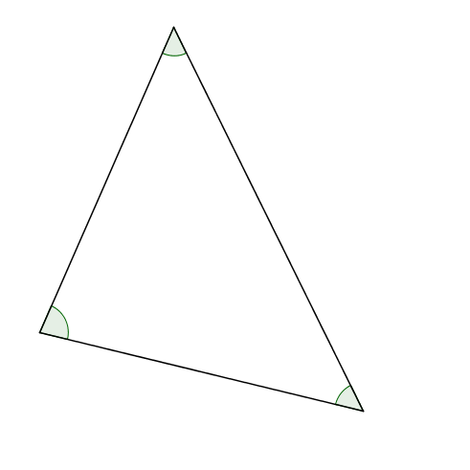
Measure the side lengths and angles of the triangle as accurately as you can.
Calculate the ratio
$$\frac{length of side}{sin⁡(angle opposite)}$$
for each side:
$$\frac{ }{ }= .$$
$$\frac{ }{ }= .$$
$$\frac{ }{ }= .$$
Construct the circle that goes through the three vertices.
Measure its diameter: _____
Sine Rule Discovery
Can you justify your findings?
SIC_2
Notes:
80

Slide 21
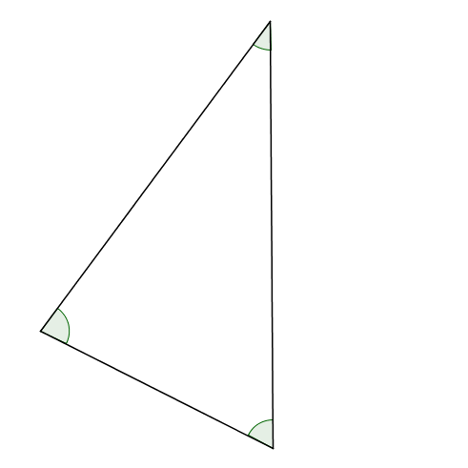
Measure the side lengths and angles of the triangle as accurately as you can.
Calculate the ratio
$$\frac{length of side}{sin⁡(angle opposite)}$$
for each side:
$$\frac{ }{ }= .$$
$$\frac{ }{ }= .$$
$$\frac{ }{ }= .$$
Construct the circle that goes through the three vertices.
Measure its diameter: _____
Sine Rule Discovery
Can you justify your findings?
SIC_2
Notes:
80

Slide 22
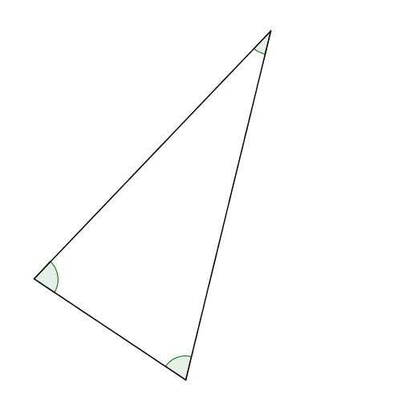
Measure the side lengths and angles of the triangle as accurately as you can.
Calculate the ratio
$$\frac{length of side}{sin⁡(angle opposite)}$$
for each side:
$$\frac{ }{ }= .$$
$$\frac{ }{ }= .$$
$$\frac{ }{ }= .$$
Construct the circle that goes through the three vertices.
Measure its diameter: _____
Sine Rule Discovery
Can you justify your findings?
SIC_2
Notes:
80

Slide 23
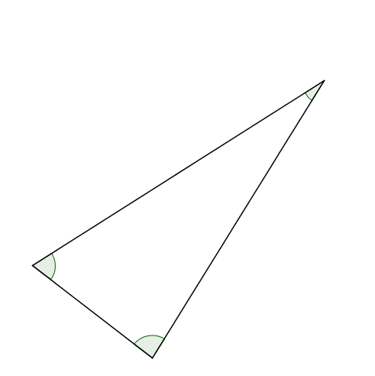
Measure the side lengths and angles of the triangle as accurately as you can.
Calculate the ratio
$$\frac{length of side}{sin⁡(angle opposite)}$$
for each side:
$$\frac{ }{ }= .$$
$$\frac{ }{ }= .$$
$$\frac{ }{ }= .$$
Construct the circle that goes through the three vertices.
Measure its diameter: _____
Sine Rule Discovery
Can you justify your findings?
SIC_2
Notes:
70

Slide 24
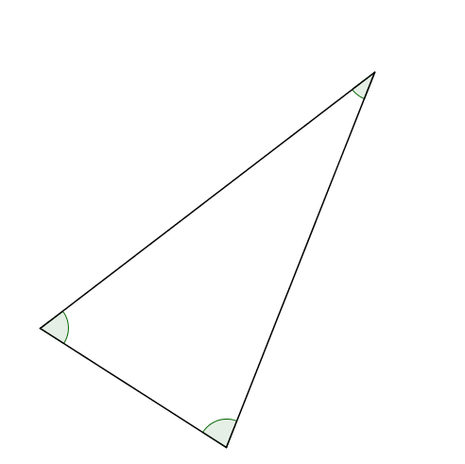
Measure the side lengths and angles of the triangle as accurately as you can.
Calculate the ratio
$$\frac{length of side}{sin⁡(angle opposite)}$$
for each side:
$$\frac{ }{ }= .$$
$$\frac{ }{ }= .$$
$$\frac{ }{ }= .$$
Construct the circle that goes through the three vertices.
Measure its diameter: _____
Sine Rule Discovery
Can you justify your findings?
SIC_2
Notes:
70

Slide 25
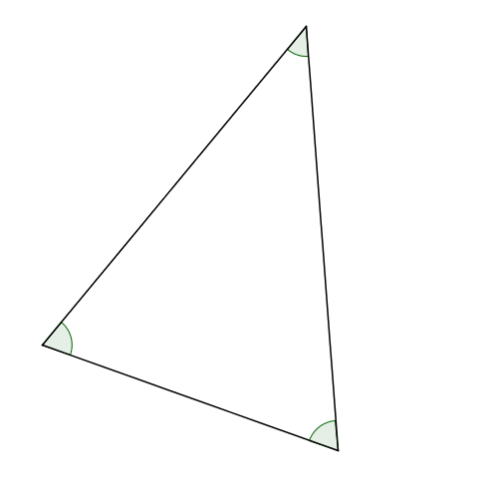
Measure the side lengths and angles of the triangle as accurately as you can.
Calculate the ratio
$$\frac{length of side}{sin⁡(angle opposite)}$$
for each side:
$$\frac{ }{ }= .$$
$$\frac{ }{ }= .$$
$$\frac{ }{ }= .$$
Construct the circle that goes through the three vertices.
Measure its diameter: _____
Sine Rule Discovery
Can you justify your findings?
SIC_2
Notes:
70

Slide 26
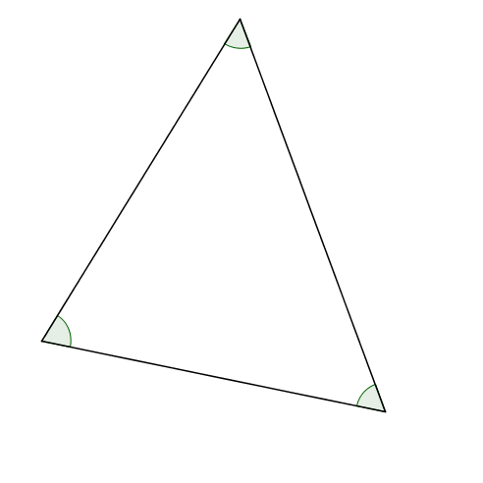
Measure the side lengths and angles of the triangle as accurately as you can.
Calculate the ratio
$$\frac{length of side}{sin⁡(angle opposite)}$$
for each side:
$$\frac{ }{ }= .$$
$$\frac{ }{ }= .$$
$$\frac{ }{ }= .$$
Construct the circle that goes through the three vertices.
Measure its diameter: _____
Sine Rule Discovery
Can you justify your findings?
SIC_2
Notes:
70

Slide 27
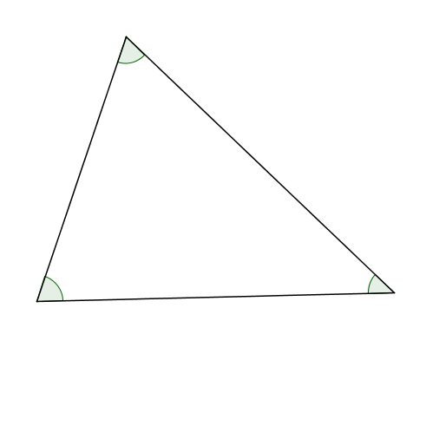
Measure the side lengths and angles of the triangle as accurately as you can.
Calculate the ratio
$$\frac{length of side}{sin⁡(angle opposite)}$$
for each side:
$$\frac{ }{ }= .$$
$$\frac{ }{ }= .$$
$$\frac{ }{ }= .$$
Construct the circle that goes through the three vertices.
Measure its diameter: _____
Sine Rule Discovery
Can you justify your findings?
SIC_2
Notes:
70

Slide 28
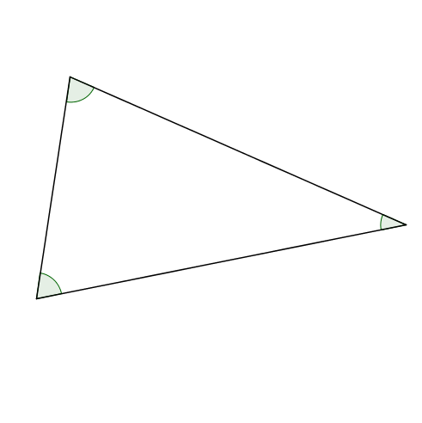
Measure the side lengths and angles of the triangle as accurately as you can.
Calculate the ratio
$$\frac{length of side}{sin⁡(angle opposite)}$$
for each side:
$$\frac{ }{ }= .$$
$$\frac{ }{ }= .$$
$$\frac{ }{ }= .$$
Construct the circle that goes through the three vertices.
Measure its diameter: _____
Sine Rule Discovery
Can you justify your findings?
SIC_2
Notes:
70

Slide 29
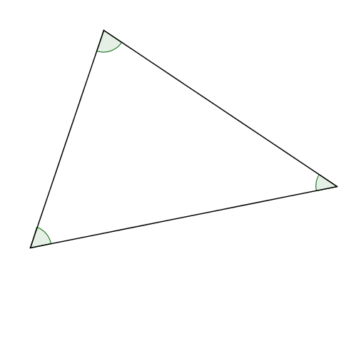
Measure the side lengths and angles of the triangle as accurately as you can.
Calculate the ratio
$$\frac{length of side}{sin⁡(angle opposite)}$$
for each side:
$$\frac{ }{ }= .$$
$$\frac{ }{ }= .$$
$$\frac{ }{ }= .$$
Construct the circle that goes through the three vertices.
Measure its diameter: _____
Sine Rule Discovery
Can you justify your findings?
SIC_2
Notes:
60

Slide 30
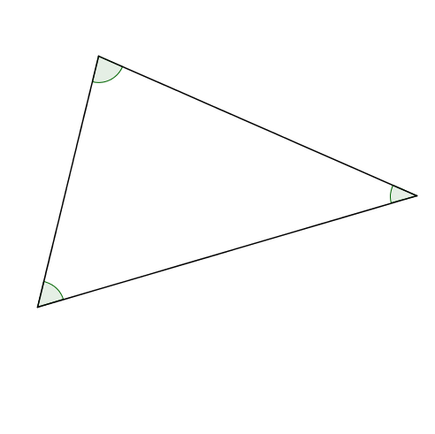
Measure the side lengths and angles of the triangle as accurately as you can.
Calculate the ratio
$$\frac{length of side}{sin⁡(angle opposite)}$$
for each side:
$$\frac{ }{ }= .$$
$$\frac{ }{ }= .$$
$$\frac{ }{ }= .$$
Construct the circle that goes through the three vertices.
Measure its diameter: _____
Sine Rule Discovery
Can you justify your findings?
SIC_2
Notes:
60

Slide 31
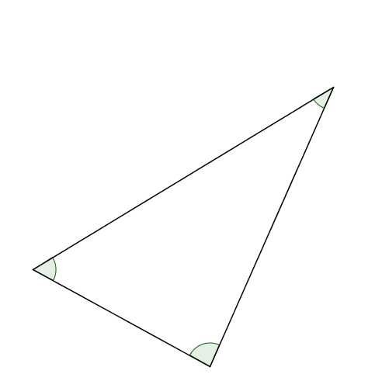
Measure the side lengths and angles of the triangle as accurately as you can.
Calculate the ratio
$$\frac{length of side}{sin⁡(angle opposite)}$$
for each side:
$$\frac{ }{ }= .$$
$$\frac{ }{ }= .$$
$$\frac{ }{ }= .$$
Construct the circle that goes through the three vertices.
Measure its diameter: _____
Sine Rule Discovery
Can you justify your findings?
SIC_2
Notes:
60

Slide 32
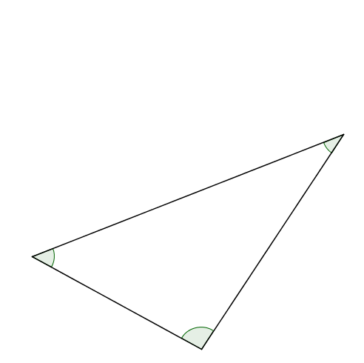
Measure the side lengths and angles of the triangle as accurately as you can.
Calculate the ratio
$$\frac{length of side}{sin⁡(angle opposite)}$$
for each side:
$$\frac{ }{ }= .$$
$$\frac{ }{ }= .$$
$$\frac{ }{ }= .$$
Construct the circle that goes through the three vertices.
Measure its diameter: _____
Sine Rule Discovery
Can you justify your findings?
SIC_2
Notes:
50

Slide 33
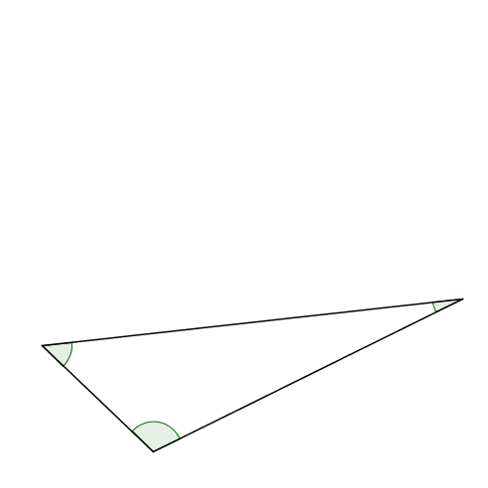
Measure the side lengths and angles of the triangle as accurately as you can.
Calculate the ratio
$$\frac{length of side}{sin⁡(angle opposite)}$$
for each side:
$$\frac{ }{ }= .$$
$$\frac{ }{ }= .$$
$$\frac{ }{ }= .$$
Construct the circle that goes through the three vertices.
Measure its diameter: _____
Sine Rule Discovery
Can you justify your findings?
SIC_2
Notes:
50

Slide 34
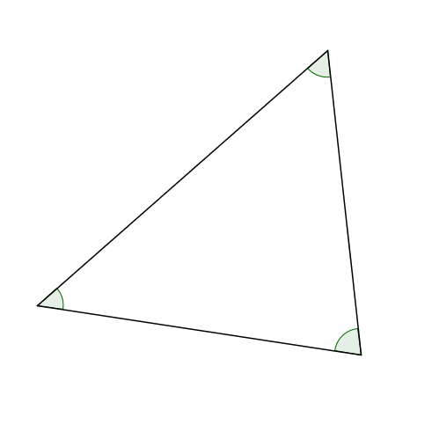
Measure the side lengths and angles of the triangle as accurately as you can.
Calculate the ratio
$$\frac{length of side}{sin⁡(angle opposite)}$$
for each side:
$$\frac{ }{ }= .$$
$$\frac{ }{ }= .$$
$$\frac{ }{ }= .$$
Construct the circle that goes through the three vertices.
Measure its diameter: _____
Sine Rule Discovery
Can you justify your findings?
SIC_2
Notes:
50

Slide 35
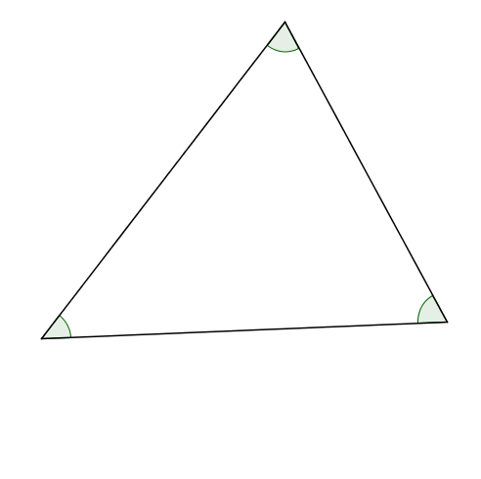
Measure the side lengths and angles of the triangle as accurately as you can.
Calculate the ratio
$$\frac{length of side}{sin⁡(angle opposite)}$$
for each side:
$$\frac{ }{ }= .$$
$$\frac{ }{ }= .$$
$$\frac{ }{ }= .$$
Construct the circle that goes through the three vertices.
Measure its diameter: _____
Sine Rule Discovery
Can you justify your findings?
SIC_2
Notes:
50

Slide 36
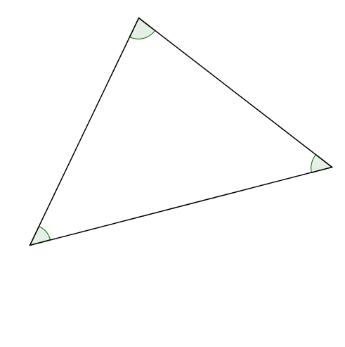
Measure the side lengths and angles of the triangle as accurately as you can.
Calculate the ratio
$$\frac{length of side}{sin⁡(angle opposite)}$$
for each side:
$$\frac{ }{ }= .$$
$$\frac{ }{ }= .$$
$$\frac{ }{ }= .$$
Construct the circle that goes through the three vertices.
Measure its diameter: _____
Sine Rule Discovery
Can you justify your findings?
SIC_2
Notes:
50

Slide 37
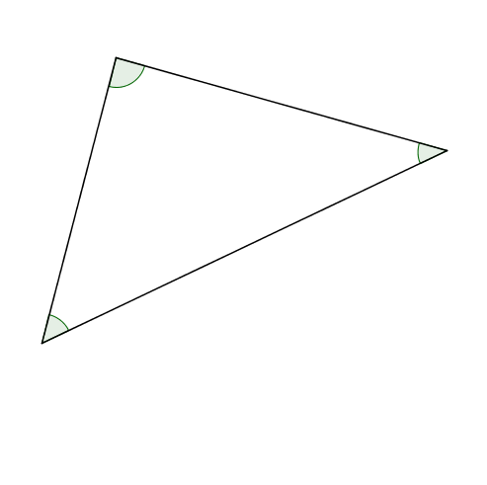
Measure the side lengths and angles of the triangle as accurately as you can.
Calculate the ratio
$$\frac{length of side}{sin⁡(angle opposite)}$$
for each side:
$$\frac{ }{ }= .$$
$$\frac{ }{ }= .$$
$$\frac{ }{ }= .$$
Construct the circle that goes through the three vertices.
Measure its diameter: _____
Sine Rule Discovery
Can you justify your findings?
SIC_2
Notes:
50

Slide 38
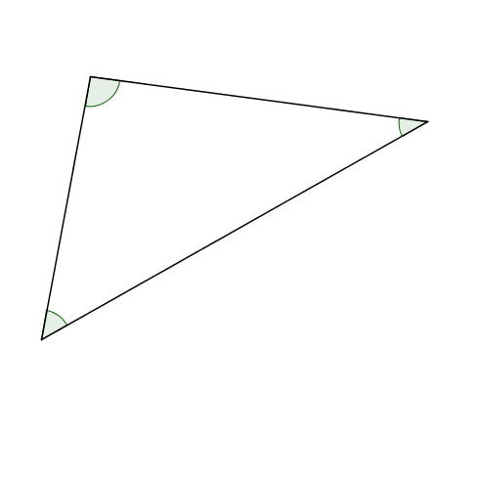
Measure the side lengths and angles of the triangle as accurately as you can.
Calculate the ratio
$$\frac{length of side}{sin⁡(angle opposite)}$$
for each side:
$$\frac{ }{ }= .$$
$$\frac{ }{ }= .$$
$$\frac{ }{ }= .$$
Construct the circle that goes through the three vertices.
Measure its diameter: _____
Sine Rule Discovery
Can you justify your findings?
SIC_2
Notes:
50

Slide 39
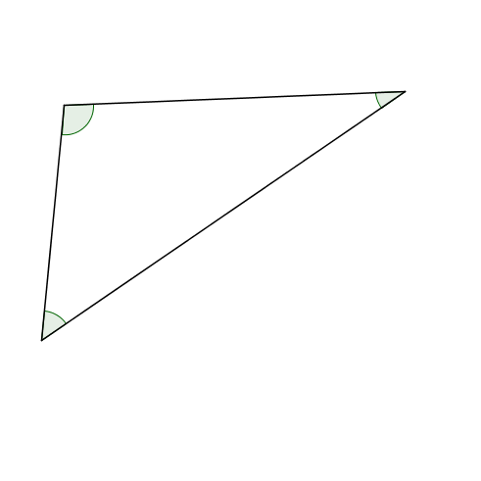
Measure the side lengths and angles of the triangle as accurately as you can.
Calculate the ratio
$$\frac{length of side}{sin⁡(angle opposite)}$$
for each side:
$$\frac{ }{ }= .$$
$$\frac{ }{ }= .$$
$$\frac{ }{ }= .$$
Construct the circle that goes through the three vertices.
Measure its diameter: _____
Sine Rule Discovery
Can you justify your findings?
SIC_2
Notes:
50

Slide 40
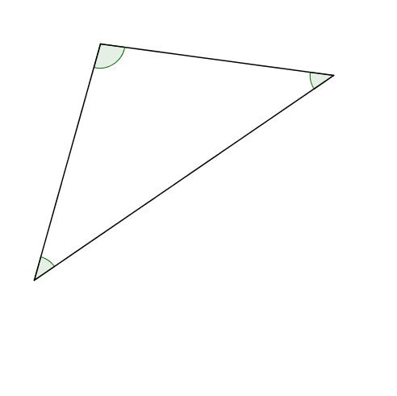
Measure the side lengths and angles of the triangle as accurately as you can.
Calculate the ratio
$$\frac{length of side}{sin⁡(angle opposite)}$$
for each side:
$$\frac{ }{ }= .$$
$$\frac{ }{ }= .$$
$$\frac{ }{ }= .$$
Construct the circle that goes through the three vertices.
Measure its diameter: _____
Sine Rule Discovery
Can you justify your findings?
SIC_2
Notes:
40

Slide 41
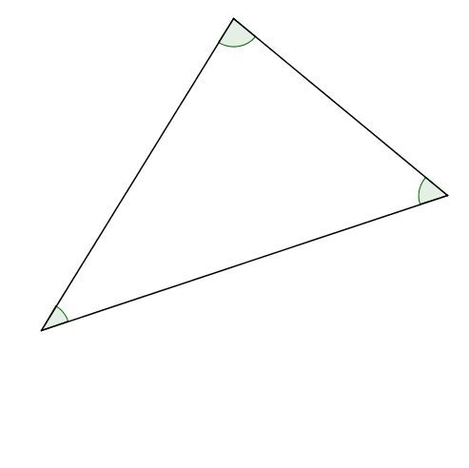
Measure the side lengths and angles of the triangle as accurately as you can.
Calculate the ratio
$$\frac{length of side}{sin⁡(angle opposite)}$$
for each side:
$$\frac{ }{ }= .$$
$$\frac{ }{ }= .$$
$$\frac{ }{ }= .$$
Construct the circle that goes through the three vertices.
Measure its diameter: _____
Sine Rule Discovery
Can you justify your findings?
SIC_2
Notes:
40

